Slide 1
Temperature Triggered Stepper Motor
Bojan Lazic

Slide 2
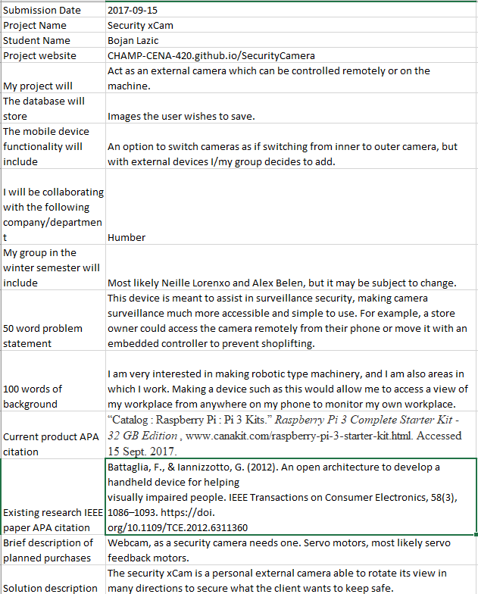
Original Proposal

Slide 3
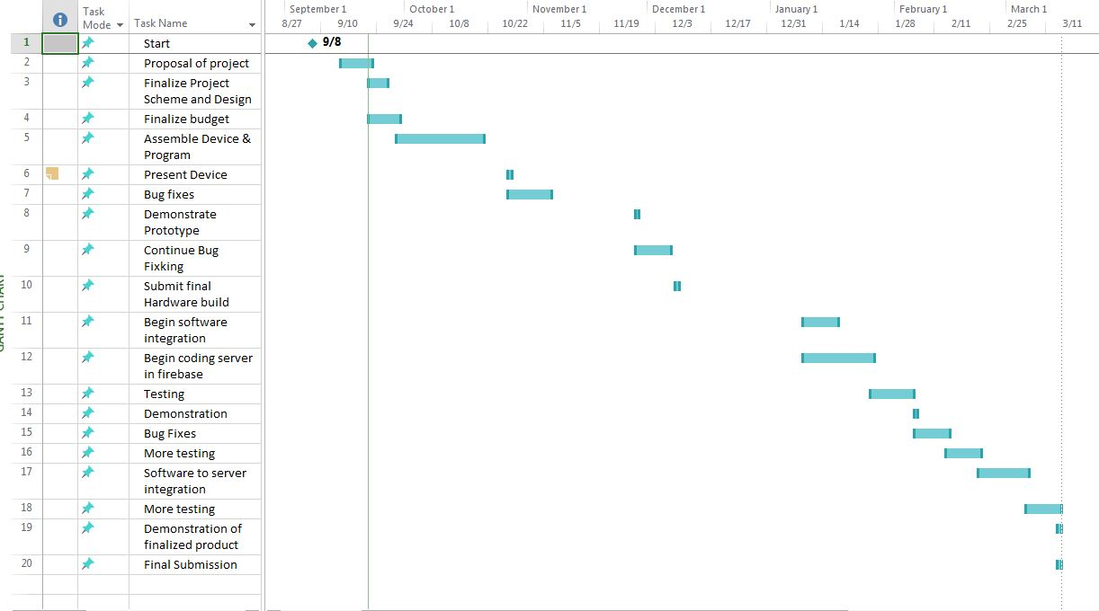
Schedule

Slide 4
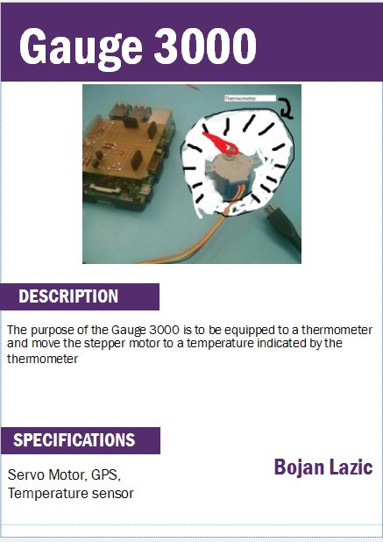
Placard Prototype

Slide 5
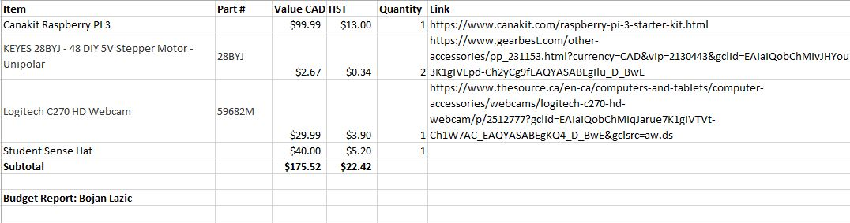
Old Budget

Slide 6
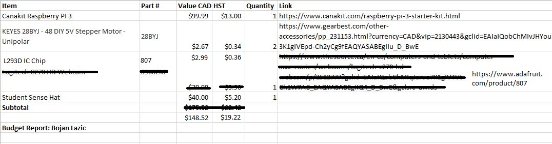
Updated Budget

Slide 7

Build Video

Slide 8
Major Courses That Helped
Intro to software engineering (CENG216)
Digital and Interface Systems (CENG215)
Unix Scripting (CENG200)
All those programming courses

